Slide 1
Simulation, Prediction, Modeling
JOUR479V/779V – Computational Journalism
University of Maryland, College Park
Nick Diakopoulos, Ph.D.

Slide 2
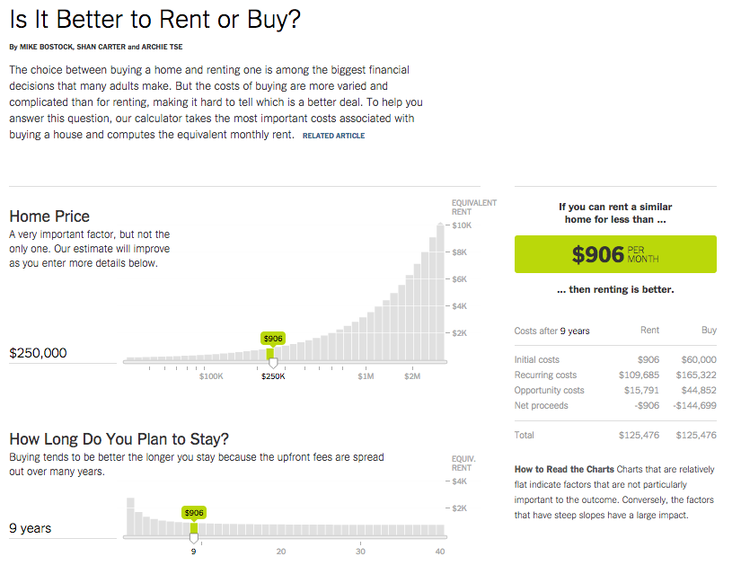
Modeling
Notes:
http://www.nytimes.com/interactive/2014/upshot/buy-rent-calculator.html?_r=0&abt=0002&abg=1
They’ve developed a pretty straightforward model that relates various parameters to the cost of renting or buying, which feeds the decision to the question “is it better to rent or buy?”
Relate to other parameters, view state, filter state, sort state, normalized data state, etc.
Point out the ease of parameterization – just dragging a slider
Can easily undo a parameter change
Can type in directly if you want
Parameters have smart defaults
Parameters are explained clearly

Slide 3
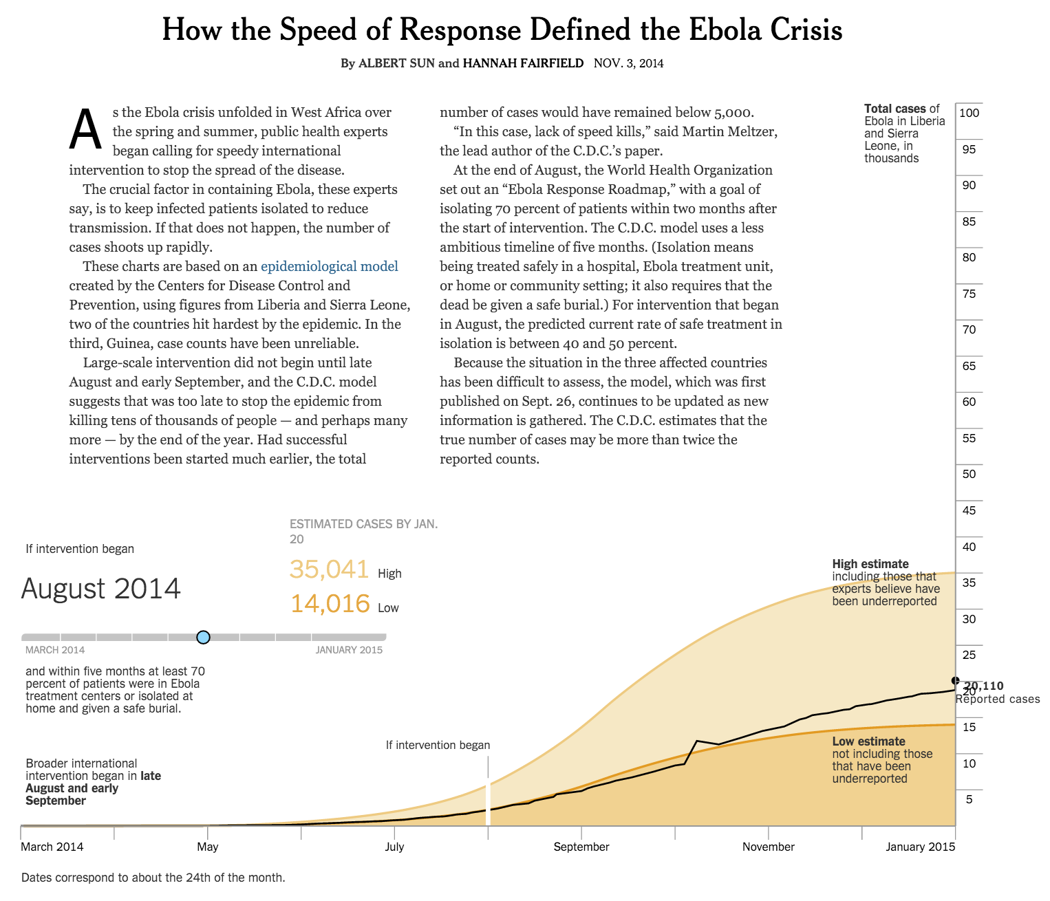
Prediction in Storytelling
http://www.nytimes.com/interactive/2014/11/04/health/visuals-ebola-model.html?_r=0
Notes:
http://www.nytimes.com/interactive/2014/11/04/health/visuals-ebola-model.html?_r=0
Another way that computing is used in the news is to create models, simulations, or predictions. We’ll talk about simulation / modeling in the context of storytelling. In this example a model was used to tell the story of how timing of the international response to the Ebola crisis would have effected the number of cases reported.

Slide 4
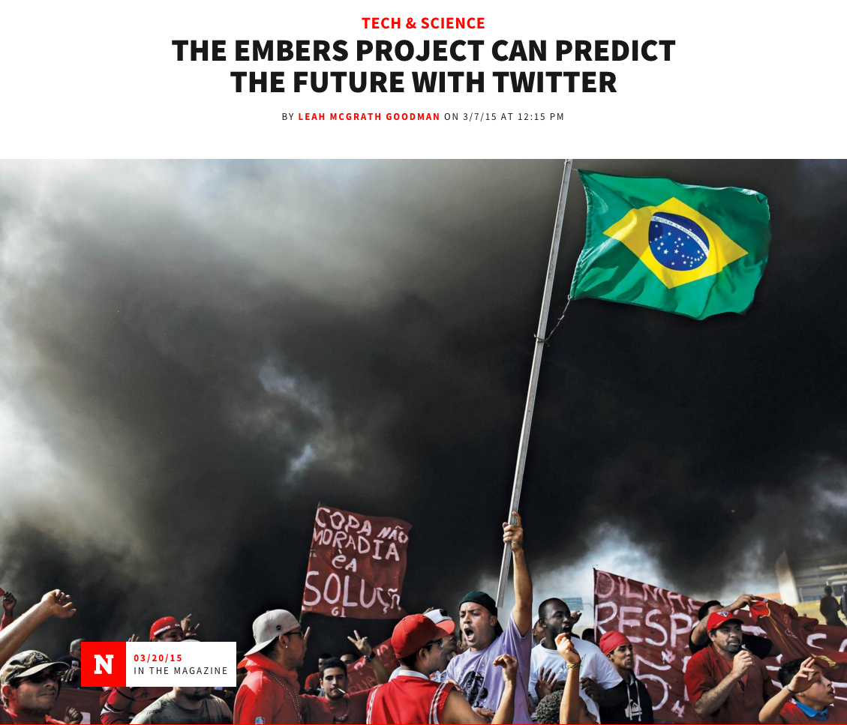
Forecasting for Story Finding
http://www.newsweek.com/2015/03/20/embers-project-can-predict-future-twitter-312063.html
Notes:
A project funded by the CIA – IARPA can predict all kinds of events from open source indicators like Twitter or news / blogs, etc. They can predict when civil unrest will break out, or when an epidemiological outbreak will hit.
Question for discussion: Journalists aren’t yet using such capabilities. How would it change newsrooms / coverage if you had a 1 day lead on some event?
http://www.newsweek.com/2015/03/20/embers-project-can-predict-future-twitter-312063.html

Slide 5
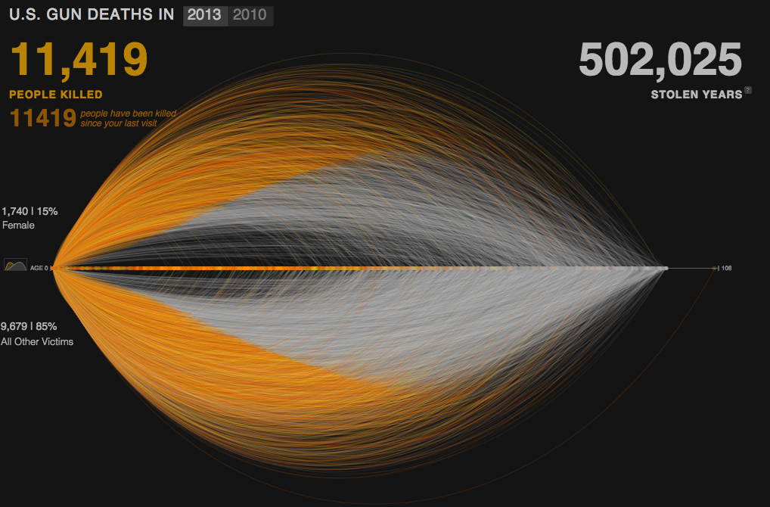
Simulation in Storytelling
http://guns.periscopic.com/?year=2013
Notes:
What’s interesting about this example is that they predict when people would have died if they weren’t killed by a gun. That prediction is based on a model build from the US census.
http://guns.periscopic.com/?year=2013

Slide 6
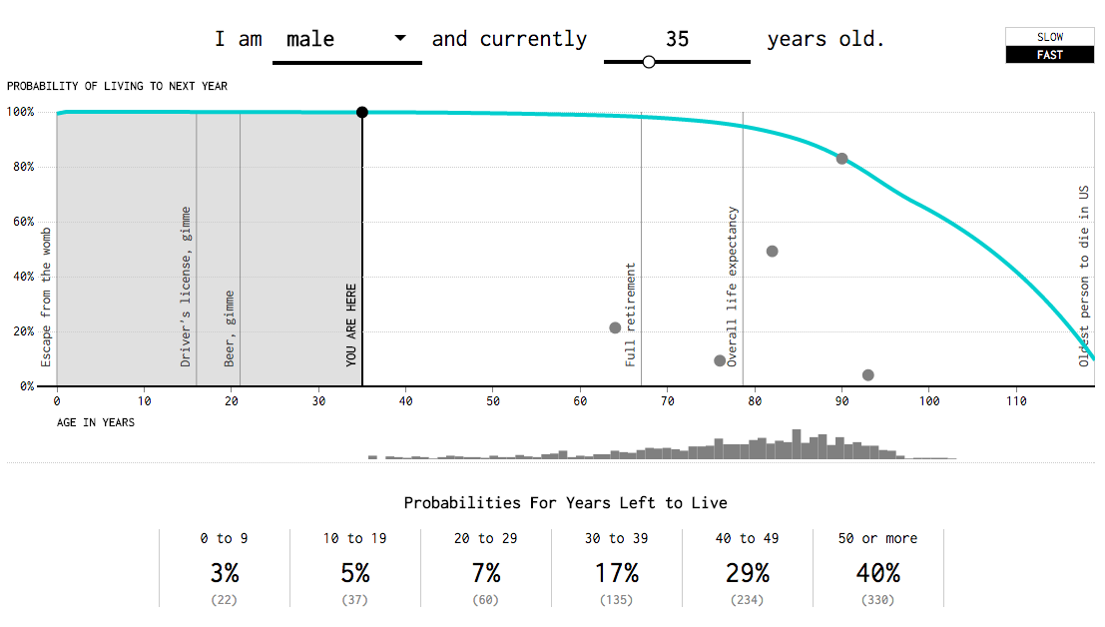
http://flowingdata.com/2015/09/23/years-you-have-left-to-live-probably/
Notes:
A more clear simulation of age based on SSA data. Interesting to see the distribution.

Slide 7
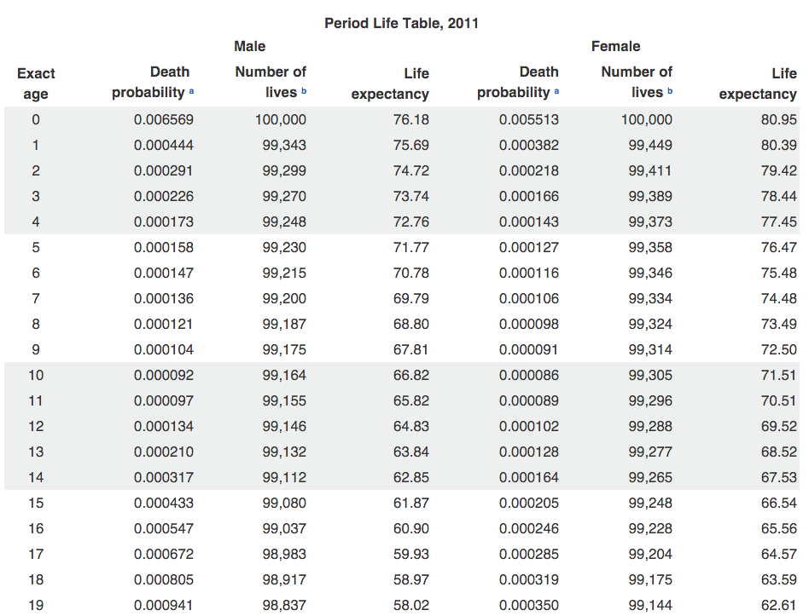
Notes:
That model is based on a table that is produced that looks something like this. There’s a lot of math and modeling behind that, but for the sake of the interactive you really just need the table version.

Slide 8
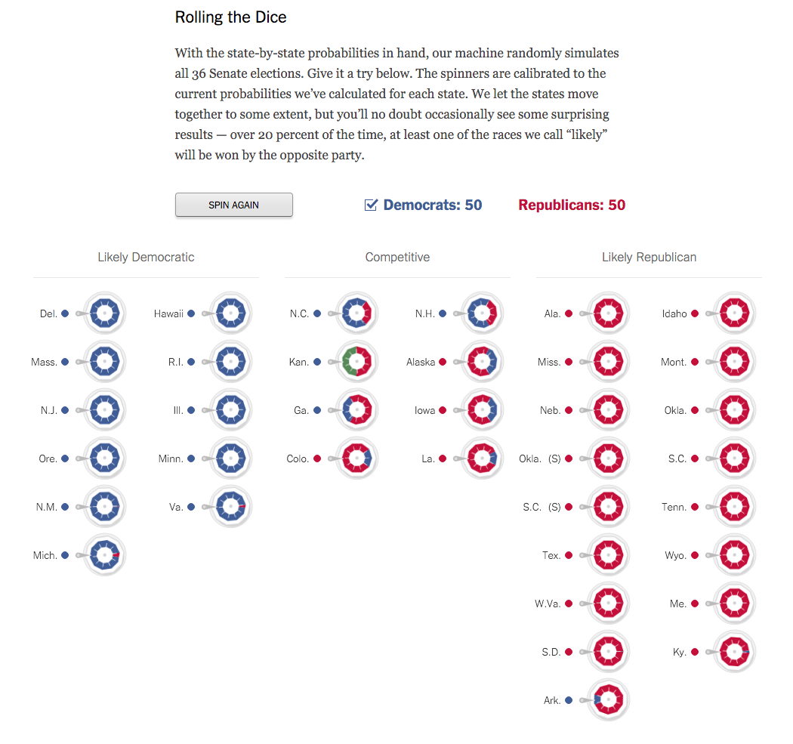
Simulation in Storytelling
http://www.nytimes.com/newsgraphics/2014/senate-model/

Slide 9
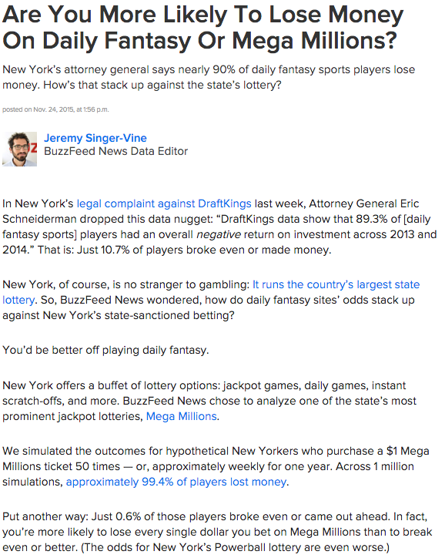
http://www.buzzfeed.com/jsvine/daily-fantasy-vs-mega-millions#.rhZwP8BGD
Notes:
Simulation doesn’t need to be accompanied by a fancy data visualization. Simulation to Make a point written in the text of this buzzfeed piece

Slide 10
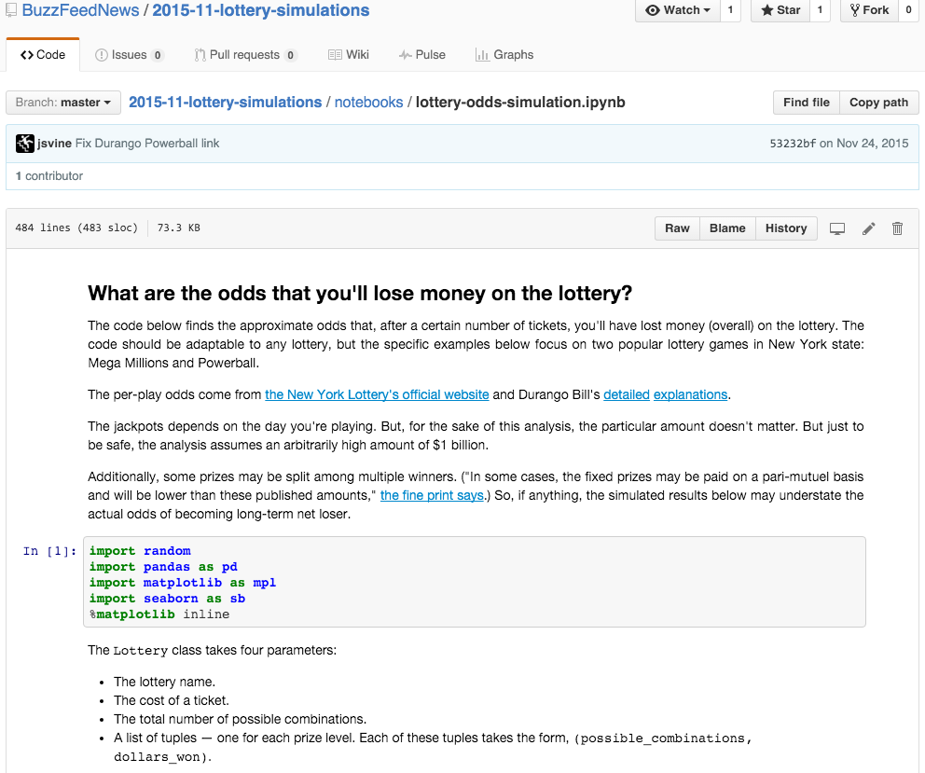
https://github.com/BuzzFeedNews/2015-11-lottery-simulations/blob/master/notebooks/lottery-odds-simulation.ipynb
Notes:
And of course they’ve put their simulation code on Github so you can inspect

Slide 11
Definitions
Model
A simplified representation of a system (entities, relationships, data)
e.g. A weather model represents atmospheric conditions and their relationships mathematically
Simulation
The activation and update of a model over time
e.g. Simulate what the weather is tomorrow by updating the weather model from minute to minute

Slide 12
Newsgames
“any intersection of journalism and gaming”
– Bogost et. al. Newsgames: Journalism at Play
Current Events
Documentary
Puzzles
Notes:
Editorial = persuasive, reportage = educational
Recommend this book for people interested in learning more about the variety of ways that gaming can be applied to journalism

Slide 13
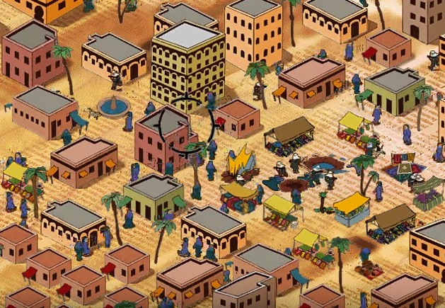
Newsgames as Simulations
https://www.youtube.com/watch?v=N1OemWEk5ns
Notes:
“any intersection of journalism and gaming”
– Bogost et. al. Newsgames: Journalism at Play

Slide 14
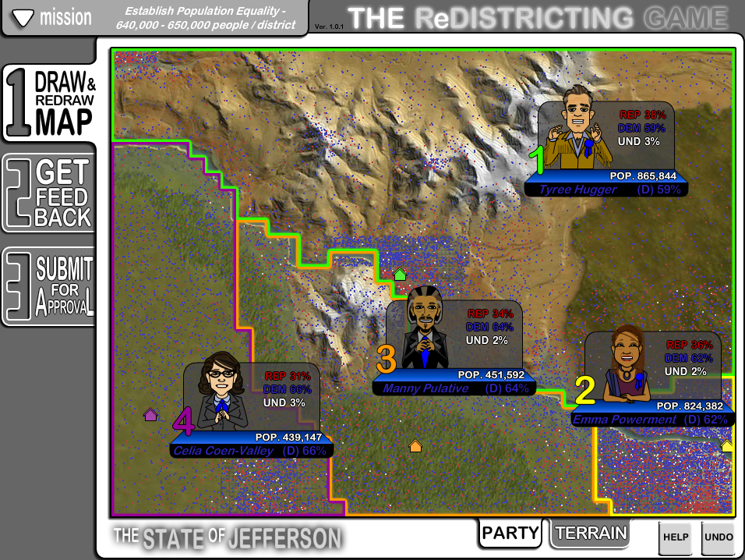
http://www.redistrictinggame.org/
Notes:
“any intersection of journalism and gaming”
– Bogost et. al. Newsgames: Journalism at Play

Slide 15
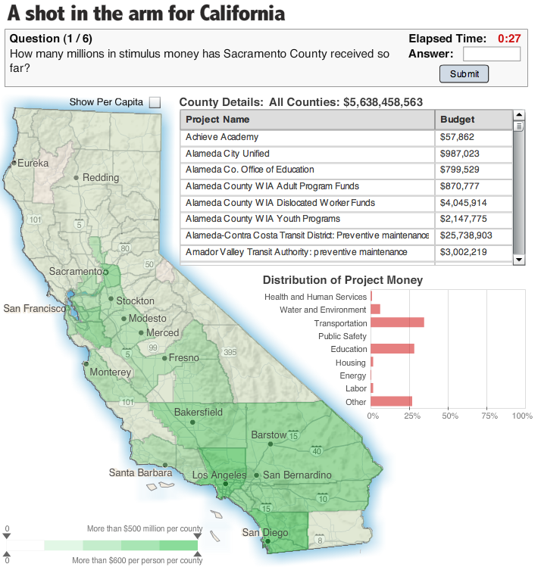
Newsgames as Puzzles / Quizzes

Slide 16
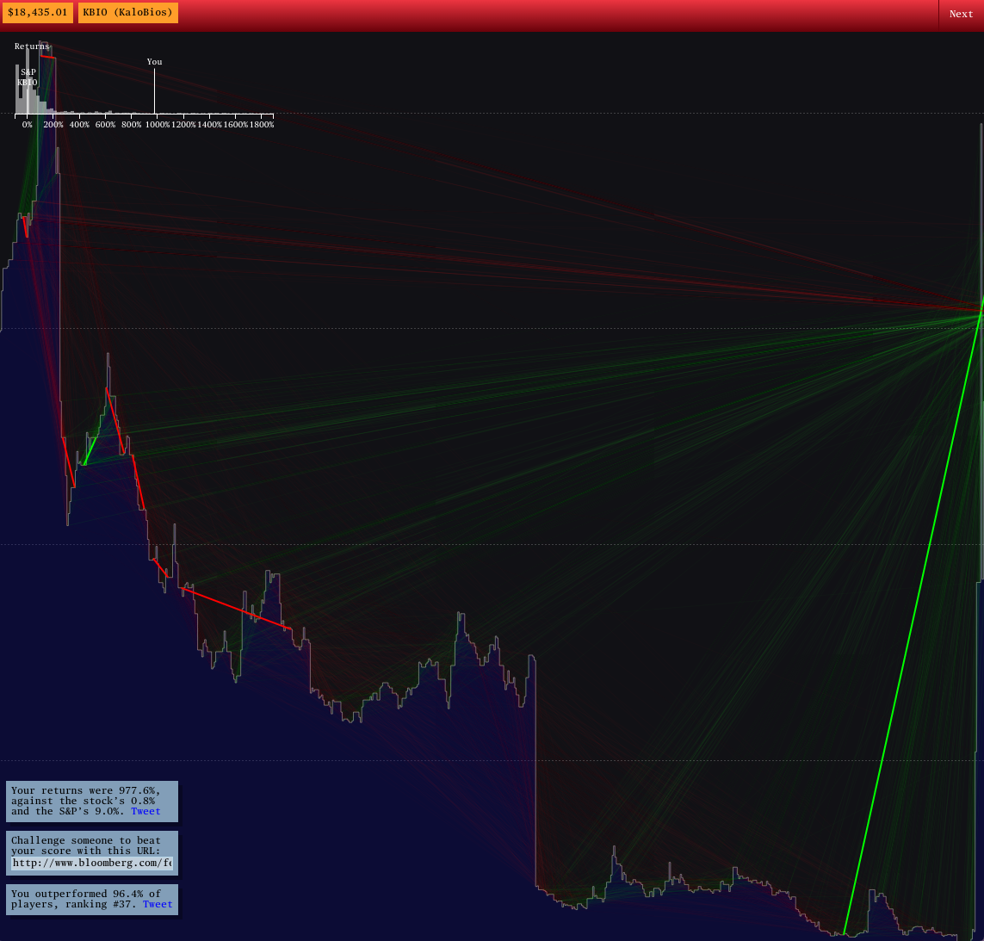
http://www.bloomberg.com/features/2015-stock-chart-trading-game/
Notes:
Games as “action” scroller. This one is also interesting b/c it integrates real data into it.
http://www.bloomberg.com/features/2015-stock-chart-trading-game/

Slide 17
Readings
Newsgames: Journalism at Play
“games simulate how things work by constructing models that people can interact with”
What are some of the pros and cons to using games to present the news?
What are challenges for newsgame production or adoption?
Notes:
Con: it’s always a simplified model, is it accurate?
Pro: it’s a more salient experience to let someone understand a process or system
Challenges: how to integrate into production workflow; time / cost not suited to all types of stories

Slide 18
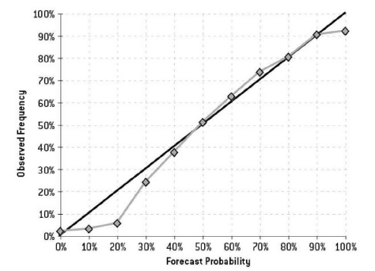
Readings
The Signal and the Noise (4&7)
What are some of the challenges associated with accurate prediction of things like flu, weather, or politics? What are ethical implications?
How should you interpret the following?: “There’s a 60 percent chance of rain tomorrow”
What makes a forecast good in the
context of journalism? Should they
be adulterated? What are the risks
of a bad model or prediction in
Journalism?
Notes:
Challenges: extrapolating an exponent is tough b/c if you’re off by a little at the start it leads to a big error later on; hard to get good estimates for the spreading factor and the fatality rate
The act of predicting can affect behaviior (feedback loops with public – ethics for journalism?); self fulfilling prophecy and self canceling prediction
Assumptions about SIR model don’t match reality (e.g. that everyone behavior the same or that the real conditions are specific and different like in those miltary barracks)
Interpretation of forecast: in 60 percent of simulations (with different starting conditions) it rained tomorrow.
What types of value to people add on top of computer forecasts and how?
They use visualization to understand and correct weaknesses of models
They bias the outcomes in specific commercial ways.
Good: accurate, honest, economic value
What’s a self canceling prediction?
Graph shows a wet bias in forcast

Slide 19
Readings
The Parable of Google Flu
What are some of the explanations offered for why Google Flu Trends predictions were off?
How might a data journalist add to the Google Flu analysis presented here? How might they approach this differently than a data scientist?
Notes:
Explanations: feedback loops (recommended searches) inflate data for some searches, Other people manipulating system possible too. Basically the temporal feedback elements.
Journalistic approach: don’t just observe the outcomes, but also talk to the engineers behind it; understand what kinds of algorithm design changes might have related to what they were observing.

Slide 20


Slide 21
Questions?

